Slide 1


Economic Efficiency in Markets and Introduction to Market Failure
AQA 3.1.5.1

Slide 2
Economic Efficiency
How well are scarce resources used? This is what is discussed when economists talk about economic efficiency
Efficiency is about a society making optimal use of scarce resources to help satisfy changing wants & needs
There are several meanings of efficiency but they all link to how well a market system allocates our scarce resources to satisfy consumers
Normally the market mechanism is good at allocating these inputs, but there are occasions when the market can fail
Allocative
Productive
Dynamic
Social

Slide 3
Allocative Efficiency using a Price Theory Diagram
Economic efficiency means making optimum use of scarce resources
Price
R
Allocative efficiency is at an output which maximizes total consumer welfare
Supply
Consumer surplus
S
P
Producer surplus
Demand
At the market equilibrium price, consumer and producer surplus is maximized – at this output, economic welfare is maximized.
Q
O
T
Quantity

Slide 4
Allocative Efficiency
Allocative efficiency is reached when no one can be made better off without making someone else worse off. This is also known as Pareto efficiency
Allocative efficiency occurs when the value that consumers place on a good or service (reflected in the price they are willing and able to pay) equals the cost of the factor resources used up in production.
The main condition required for allocative efficiency in a given market is that market price = marginal cost of supply
All points that lie on the PPF are allocatively efficient because we cannot produce more of one product without affecting the amount of all other products available.
Outputof Beer
A
X1
B
X2
C
X3
Y1
Y2
Y3
Output of Cheese

Slide 5
Productive Efficiency
A firm is productively efficient when it is operating at the lowest point on its average cost curve i.e. unit costs have been minimised
Productive efficiency exists when producers minimize the wastage of resources
Productive efficiency also relates to when an economy is on their production possibility frontier
An economy is productively efficient if it can produce more of one good only by producing less of another.
Cost Per Unit
Productive efficiency is achieved when the long run unit cost of production is at a minimum
Average Cost
Output

Slide 6
Social Efficiency
The socially efficient level of output and/or consumption occurs when marginal social benefit (MSB) = marginal social cost (MSC)
The existence of negative and positive externalities means that the private level of consumption or production differs from social optimum
The free market price mechanism does not always take into account social costs and benefits
Costs, Benefits
Social optimum output is where MSC = MSB
MSC
P2
MPC
P1
MSB
MPB
Q1
Q2
Output

Slide 7
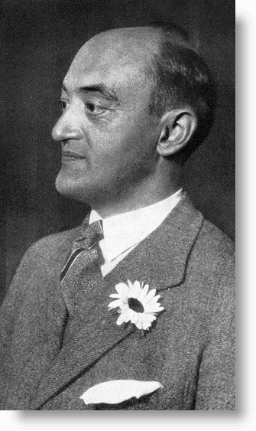
Dynamic Efficiency in Markets: Innovation
Innovation is putting a new idea or approach into action. Innovation is 'the commercially successful exploitation of ideas'
Product innovation
  Small-scale and frequent subtle changes to the characteristics and performance of a good or a service
Process innovation
  Changes to the way in which production takes place or is organised
  Changes in business models and pricing strategies
Innovation has demand and supply-side effects in markets and the economy as a whole
Austrian economist Joseph Schumpeter (pictured) coined the term creative destruction which refers to the upheaval of the established order in the pursuit of innovation. Smaller disruptive businesses often challenge existing firms!

Slide 8
What is Market Failure?
Market failure is when the price mechanism leads to an inefficient allocation of resources and a deadweight loss of economic welfare
Negative externalities
Positive externalities
Merit goods
De-merit goods
Public goods
Information failures
Monopolies
Immobility of factor inputs

Slide 9
Economic Efficiency in Markets and Introduction to Market Failure
AQA 3.1.5.1

